Slide 1
PROTOTYPE DEVELOPMENT II
SESSION III
DOCUMENTATION

Slide 2
Learning Objectives
LO 1 : Design physical / visual representation and constructive breakthrough of business ideas

Slide 3
Subtopics
Documentation

Slide 4
Documentation

Slide 5
Documentation
It is important for teams to document the core aspects of each step, as soon as possible
This documentation step ensures that the valuable information and ideas that inspired the ideation and development of the first prototypes are saved

Slide 6
Documentation I
Understand – Use the Post-its on which you have noted the cluster names or main questions from this phase (e.g. general conditions, goal, budget, concerns, target group…)
Observe – List the different research tools you have used and give a quantitative impression (e.g. five interviews, three internet articles, two expert lectures, two book excerpts, three self-experiments …)
Synthesize – Take advantage of the Post-its and templates you have created during this step. Give a keyword-like overview of the main findings you have gained from the observation results. What topics have you selected to use for your persona? What insights have you formulated?

Slide 7
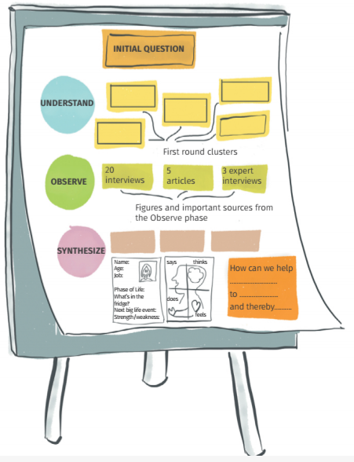
Documentation I

Slide 8
Documentation II
Ideate – Select only those ideas you later used for prototyping
Prototype – Later you can insert photos of your prototype(s). For the final presentation, you can use the original prototype, of course
Test – Print out the feedback grid or draw it on the flipchart here

Slide 9
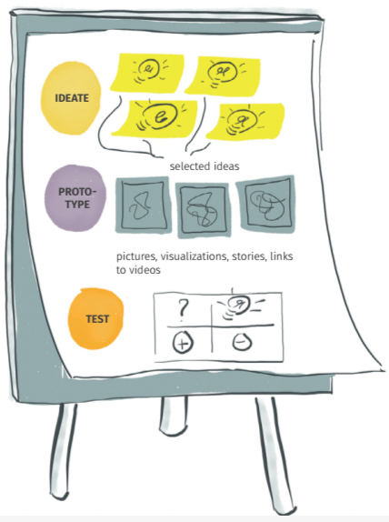
Documentation II

Slide 10
Student Activities

Slide 11
Student Activities
Review business idea by using design thinking documentation

Slide 12
Session 5 Preparation

Slide 13
Session 5 Preparation
Learn Feedback Grid
Prepare prototype concept to be discussed

Slide 14
References
Osann, I., Mayer, L., & Wiele, I. (2020). The Design Thinking Quick Start Guide: A 6-step Process for Generating and Implementing Creative Solutions. John Wiley & Sons.

